Slide 1
Code Basics Resume Challenge 13

Slide 2
Problem Statement
Goodcabs, a cab service company established two years ago, has gained a strong foothold in the Indian market by focusing on tier-2 cities. Unlike other cab service providers, Goodcabs is committed to supporting local drivers, helping them make a sustainable living in their hometowns while ensuring excellent service to passengers. With operations in ten tier-2 cities across India, Goodcabs has set ambitious performance targets for 2024 to drive growth and improve passenger satisfaction.
As part of this initiative, the Goodcabs management team aims to assess the company’s performance across key metrics, including trip volume, passenger satisfaction, repeat passenger rate, trip distribution, and the balance between new and repeat passengers.

Slide 3
AD HOC Requests

Slide 4
Business Request - 1
City-Level Fare and Trip Summary Report
Generate a report that displays the total trips, average fare per km, average fare per trip, and the percentage contribution of each city’s trips to the overall trips. This report will help in assessing trip volume, pricing efficiency, and each city’s contribution to the overall trip count.

Slide 5
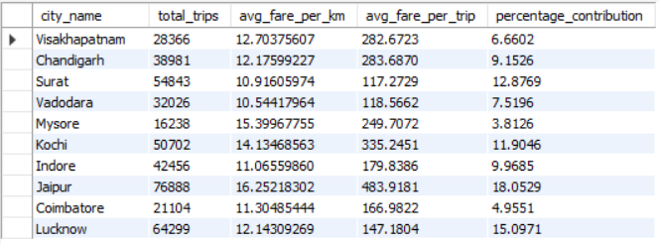

Slide 6
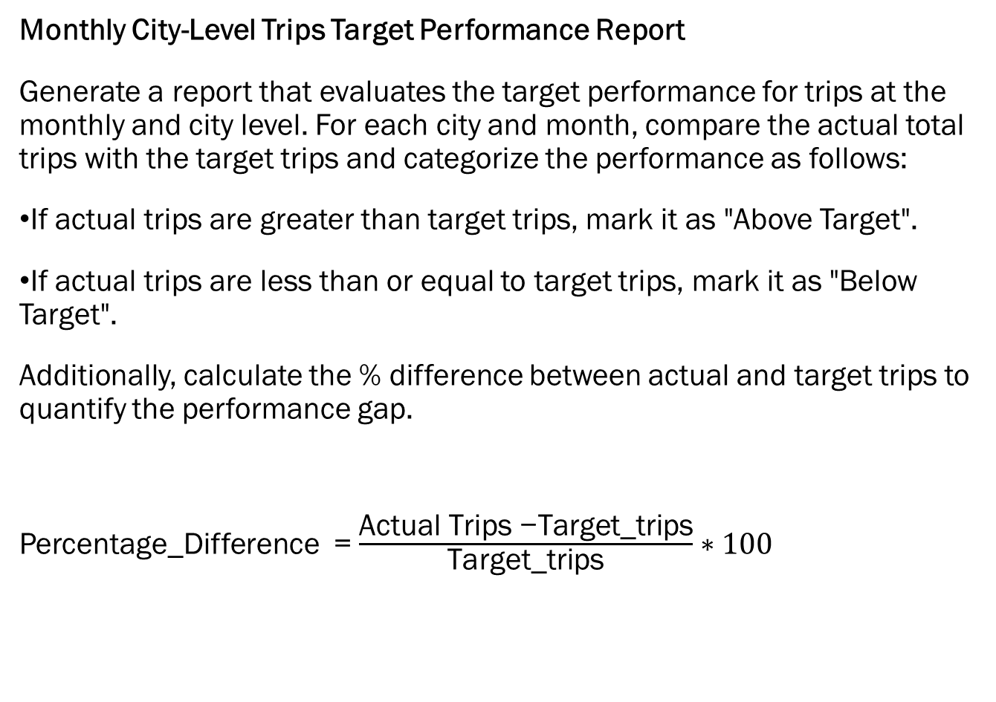
Business Request - 2
Monthly City-Level Trips Target Performance Report
Generate a report that evaluates the target performance for trips at the monthly and city level. For each city and month, compare the actual total trips with the target trips and categorize the performance as follows:
If actual trips are greater than target trips, mark it as "Above Target".
If actual trips are less than or equal to target trips, mark it as "Below Target".
Additionally, calculate the % difference between actual and target trips to quantify the performance gap.
Percentage_Difference = $\frac{\text{Actual} \text{Trips}\text{ −}\text{Target}\text{_}\text{trips}}{\text{Target}\text{_}\text{trips}}∗100$

Slide 7
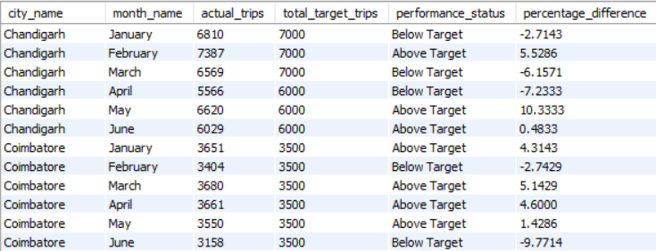
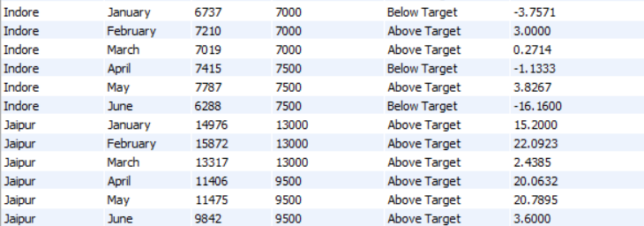

Slide 8
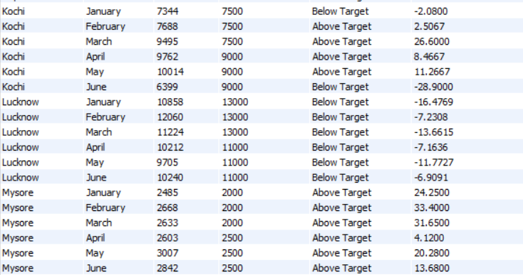
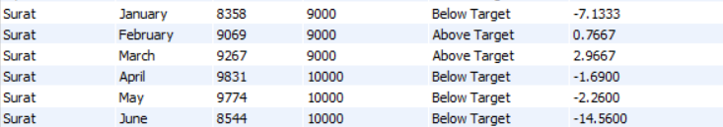

Slide 9
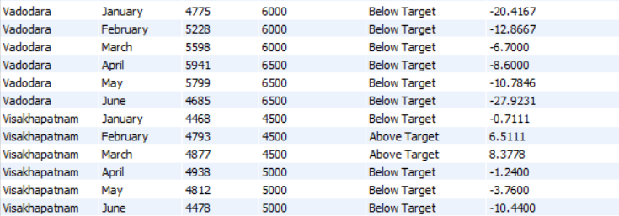

Slide 10
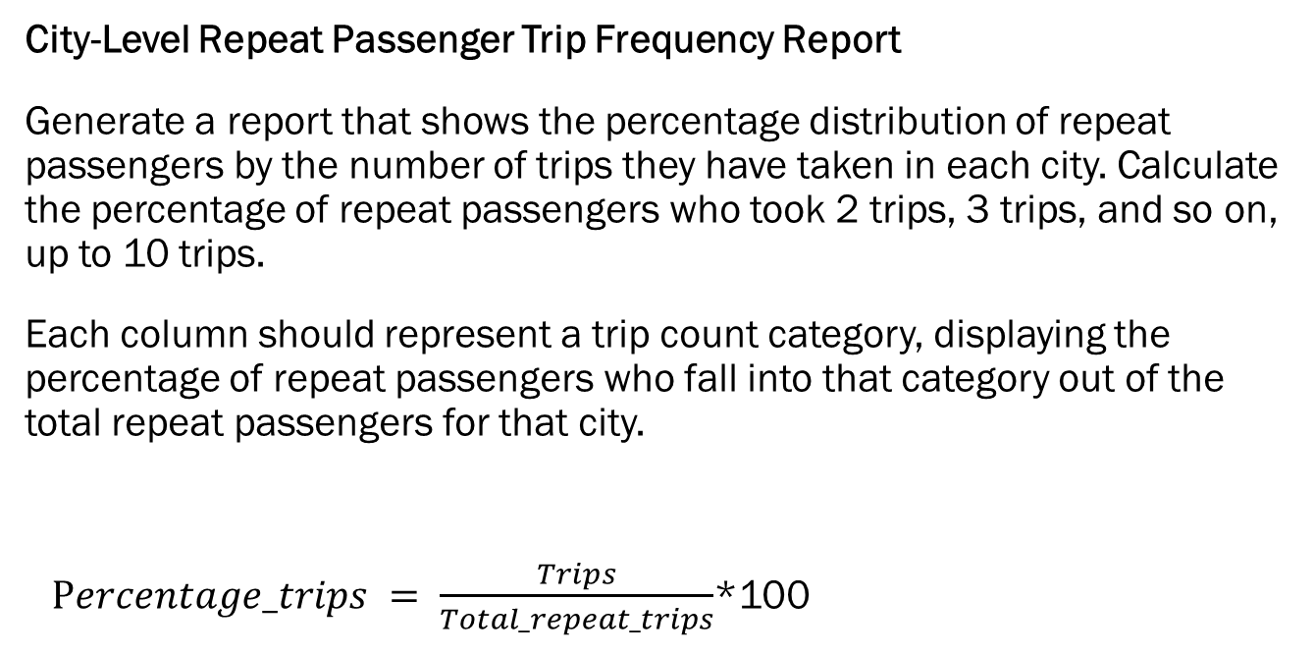
Business Request - 3
City-Level Repeat Passenger Trip Frequency Report
Generate a report that shows the percentage distribution of repeat passengers by the number of trips they have taken in each city. Calculate the percentage of repeat passengers who took 2 trips, 3 trips, and so on, up to 10 trips.
Each column should represent a trip count category, displaying the percentage of repeat passengers who fall into that category out of the total repeat passengers for that city.
$Percentage_trips = \frac{Trips}{Total_repeat_trips}$*100

Slide 11
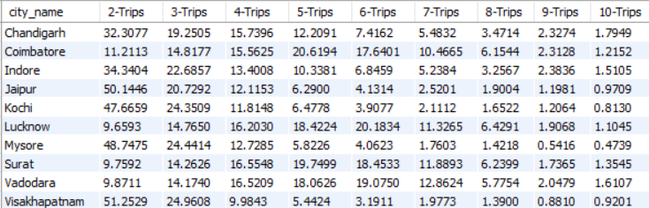

Slide 12
Business Request – 4
Identify Cities with Highest and Lowest Total New Passengers
Generate a report that calculates the total new passengers for each city and ranks them based on this value. Identify the top 3 cities with the highest number of new passengers as well as the bottom 3 cities with the lowest number of new passengers, categorizing them as "Top 3" or "Bottom 3" accordingly.

Slide 13
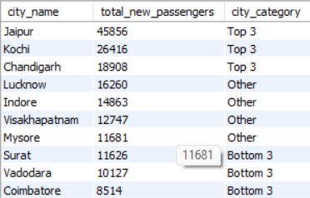

Slide 14
Business Request – 5
Identify Month with Highest Revenue for Each City
Generate a report that identifies the month with the highest revenue for each city. For each city, display the month_name, the revenue amount for that month, and the percentage contribution of that month’s revenue to the city’s total revenue.

Slide 15
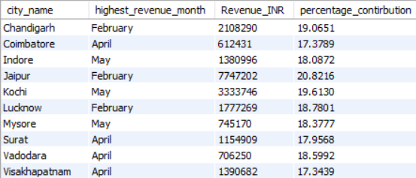

Slide 16
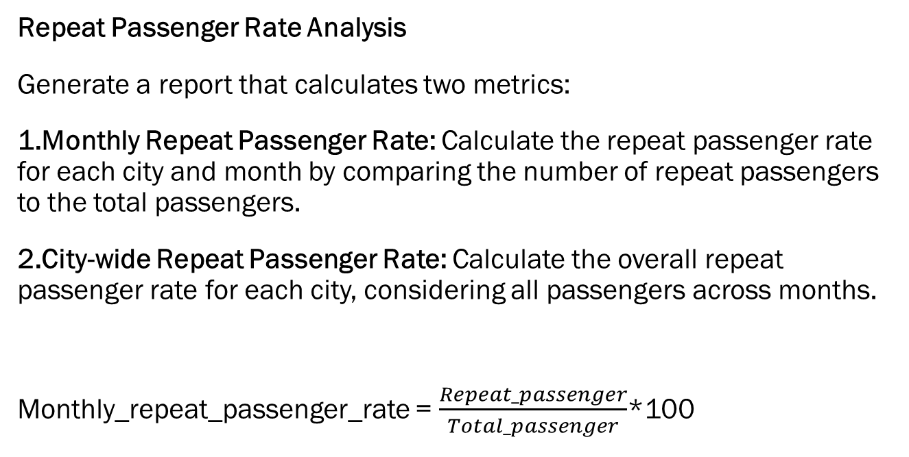
Business Request - 6
Repeat Passenger Rate Analysis
Generate a report that calculates two metrics:
Monthly Repeat Passenger Rate: Calculate the repeat passenger rate for each city and month by comparing the number of repeat passengers to the total passengers.
City-wide Repeat Passenger Rate: Calculate the overall repeat passenger rate for each city, considering all passengers across months.
Monthly_repeat_passenger_rate = $\frac{Repeat_passenger}{Total_passenger}$*100

Slide 17
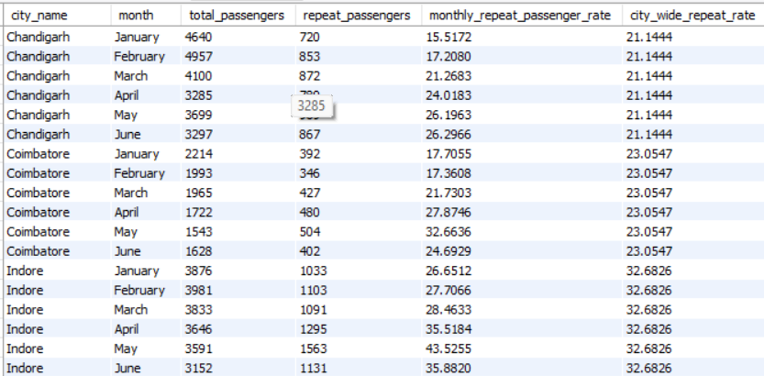

City_wide_repeat_rate = $\frac{sum_repeat_passenger}{sum_total_passenger}$*100

Slide 18
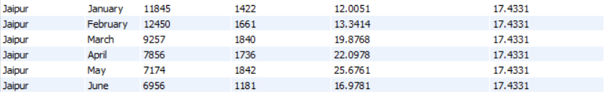
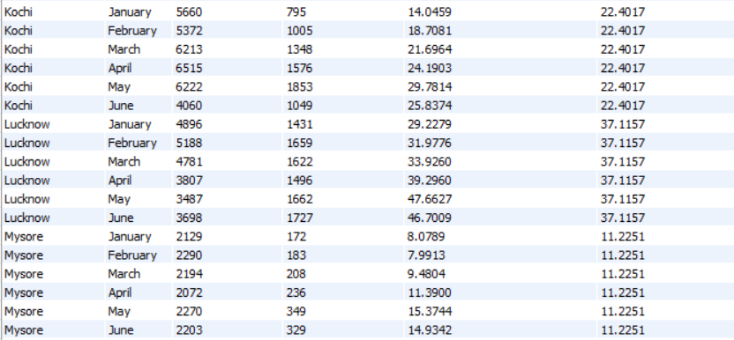

Slide 19
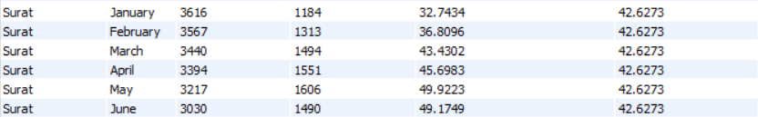
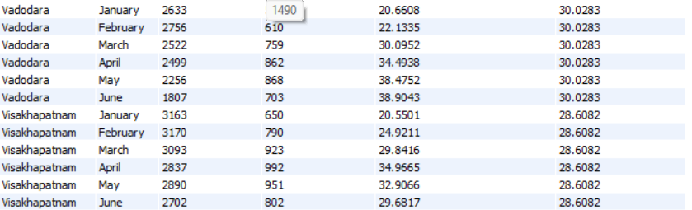

Slide 20
More Research Requests

Slide 21

Question - 1
Trip Volume Distribution on Weekday and Weekend
Here, using fact_trips and dim_date is used to calculate avg trip volume on Weekday and Weekends

Slide 22
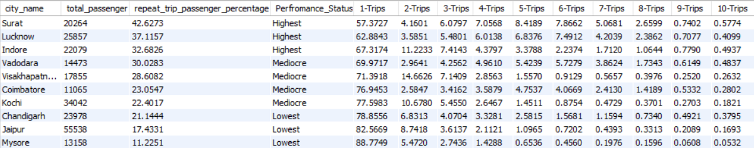
Question - 2
Passenger Repeat Rate Analysis of Each Trip Type out of Total Passengers
It provides an overall analysis of the percentage of total passengers based on the number of trips they have completed with us.

Slide 23
Question - 3
Passenger Repeat Rate Analysis wrt to Passenger Rating & Driver Rating
It is evident that the passenger repeat rate directly influences the number of repeat trips. Therefore, enhancing our customer service is crucial to increasing the repeat rate. Additionally, the company should consider implementing loyalty programs, personalized offers, and feedback mechanisms to further encourage repeat customers and strengthen passenger retention.

Slide 24
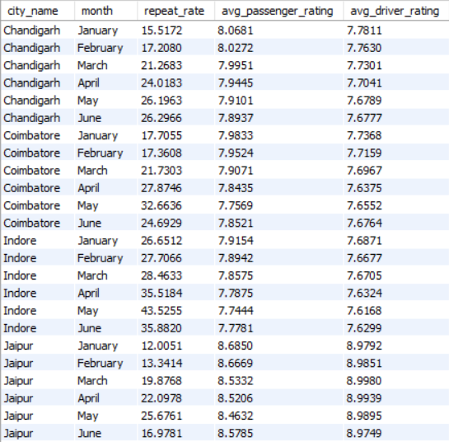

Slide 25
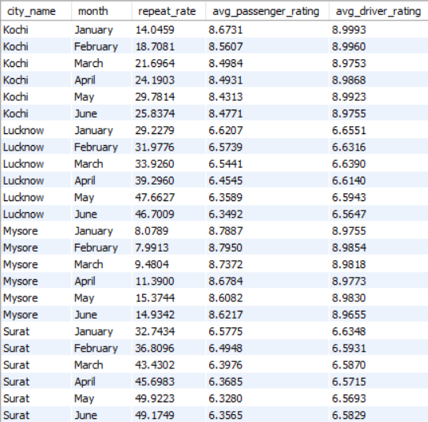

Slide 26
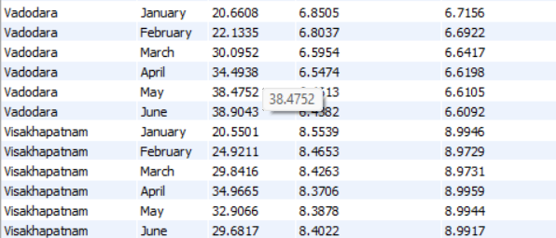

Slide 27
Question - 4
Comparison of Actual New Passengers v/s Target New Passenger
This metric will help identify cities that are falling short of their targets. Additionally, we have provided a performance status for each city, which is calculated while accounting for a margin of error or tolerance of 200 passengers.

Slide 28
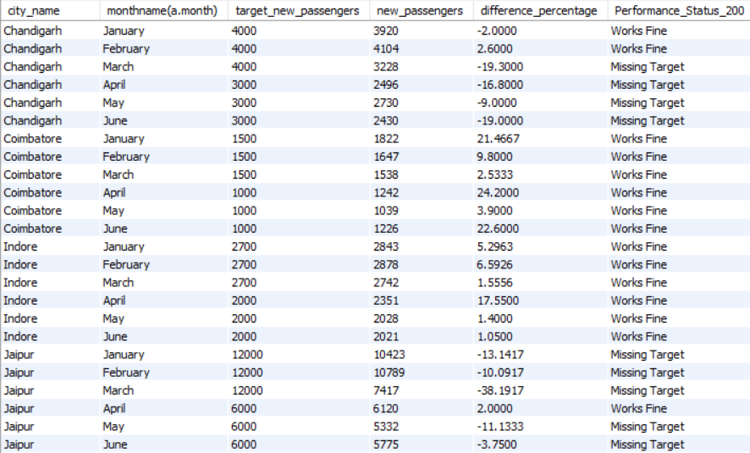

Slide 29
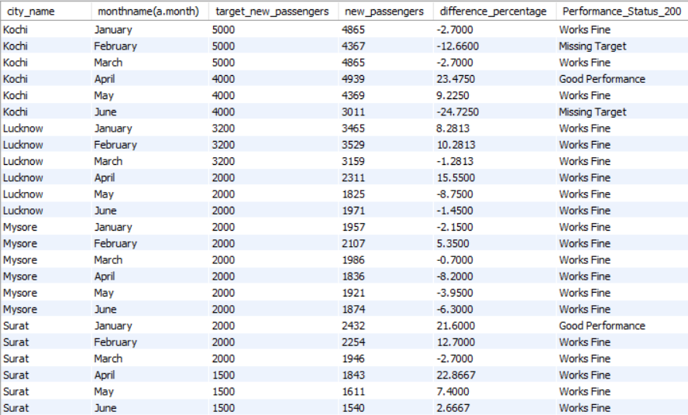

Slide 30
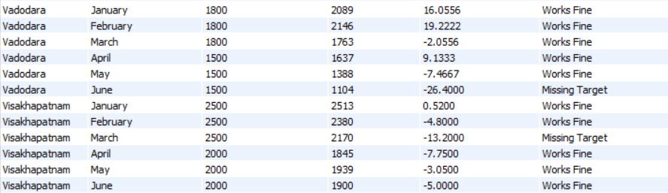

Slide 31
Question - 5
Monthly Split between trip by New Customer and Repeated Customers
Here, we present the number of trips in each month for each city, categorized by New Customers and Repeat Customers. This is a crucial metric as it helps analyze the contribution of repeat passengers to the total trips. It provides valuable insights into the performance of the customer service and marketing teams.

Slide 32
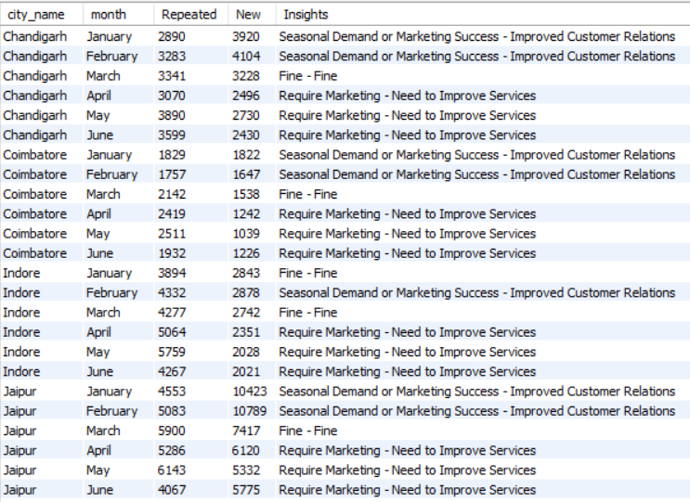

Slide 33
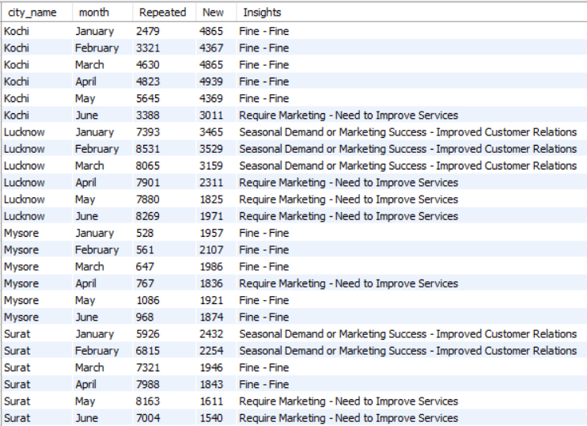

Slide 34
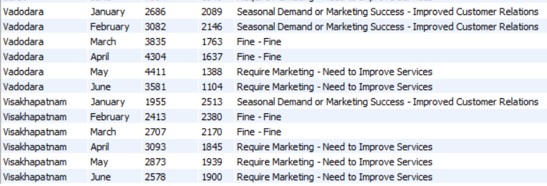

Slide 35
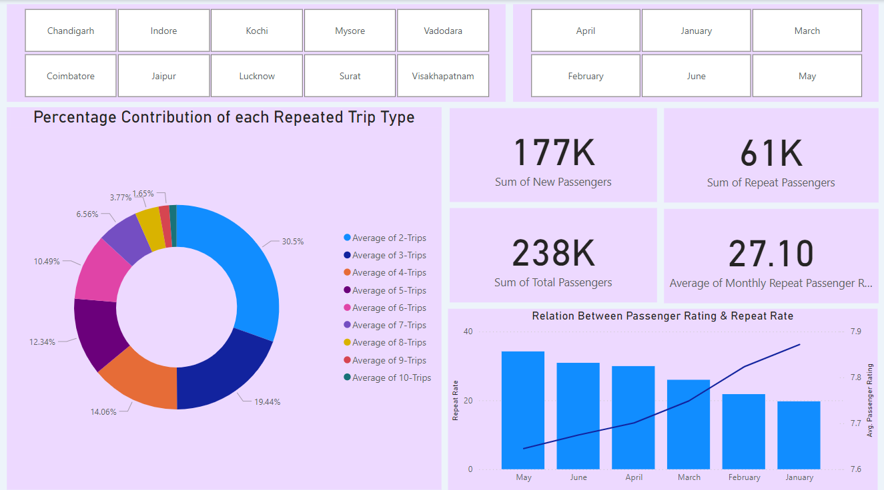

Slide 36
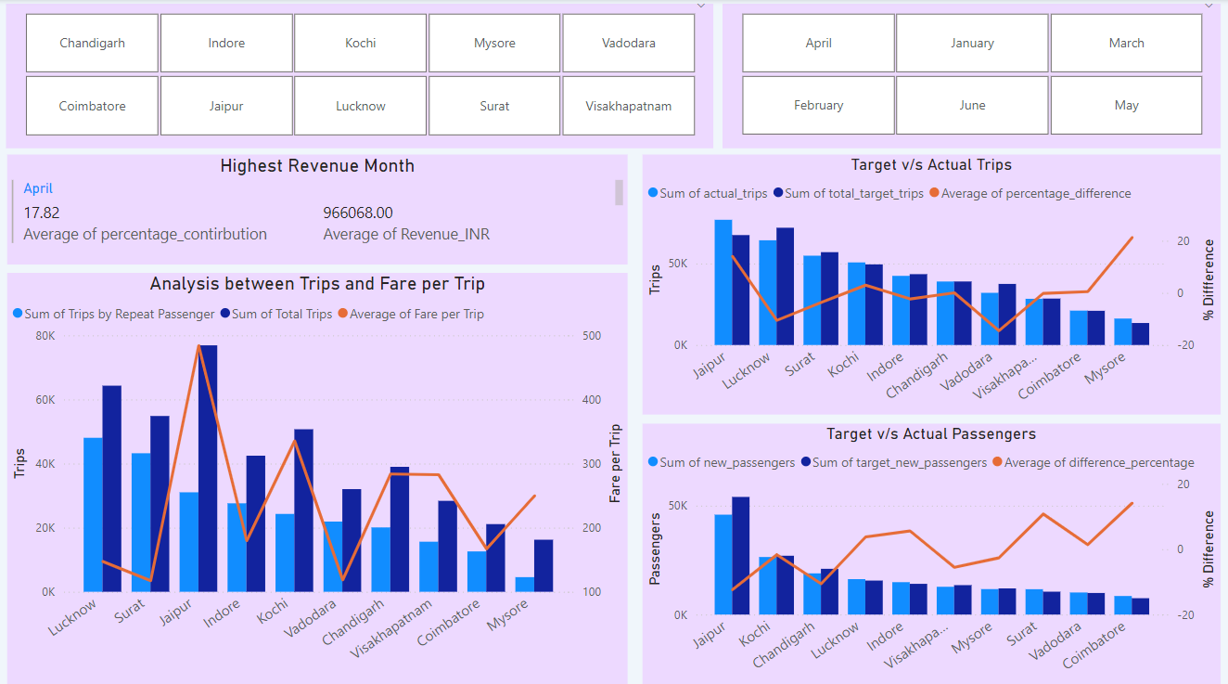

Slide 37
Future Analysis & Recommendation
What factors might contribute to higher or lower repeat passenger rates in different cities ?
Passenger Rating :
The dashboard clearly demonstrates that higher passenger ratings have a positive impact on the repeat rate.
Fare per trip :
Cities with lower fares tend to have a higher repeat rate, as customers prefer to choose our cab services in these locations.
City Demographics :
Cities with higher populations tend to have higher repeat rates, as the demand for transportation services is greater. Similarly, cities with significant economic activity exhibit higher repeat rates due to increased commuting needs and frequent travel by residents and businesses.

Slide 38
Future Analysis & Recommendation
Tourism vs. Business Demand Impact
How do tourism seasons or local events impact Goodcabs demand patterns? Would tailoring marketing efforts to these events increase trip volume in tourism-oriented cities?
Festivals and events (such as concerts and matches) have a significant positive impact on trip volumes, driving increased demand for transportation services.
Additionally, focused marketing efforts can help expand our consumer base, leading to a substantial rise in the number of new passengers and overall growth.

Slide 39
Future Analysis & Recommendation
Partnership Opportunities with Local Businesses
Are there opportunities for Goodcabs to partner with local businesses (such as hotels, malls, or event venues) to boost demand and improve customer loyalty? Could these partnerships drive more traffic, especially in tourism-heavy or high-footfall areas?
Partnering with local cab services in high-footfall areas and tourist destinations by offering our technological support can significantly enhance our consumer base and overall trip volume.
In cities like Kochi and Mysore, where trip volumes are relatively low, collaborating with local players would be a strategic move to increase market penetration and improve performance in these regions

Slide 40
Future Analysis & Recommendation
Data Collection for Enhanced Data-Driven Decisions
To make Goodcabs more data-driven and improve its performance across key metrics, what additional data should Goodcabs collect?
Collecting data on passenger demographics, such as occupation, address, age, income, and travel frequency, would provide valuable insights into our customer base.
This information will help us better understand our passengers and identify which segments of the population we should target to enhance our services and marketing strategies effectively.

Slide 41
Thank you
Darshan Dugar
darshan.dugar05@gmail.com
LinkedIn

